Slide 1
Map Reduce Examples
Jay Urbain, Phd

Slide 2
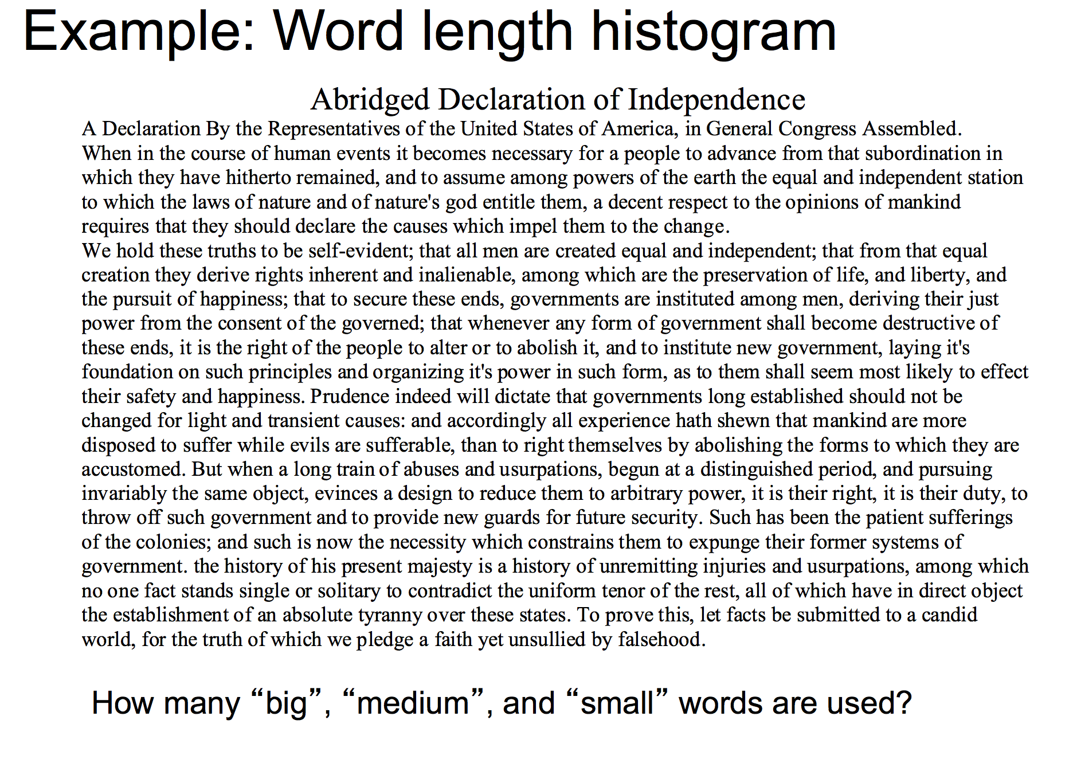

Slide 3
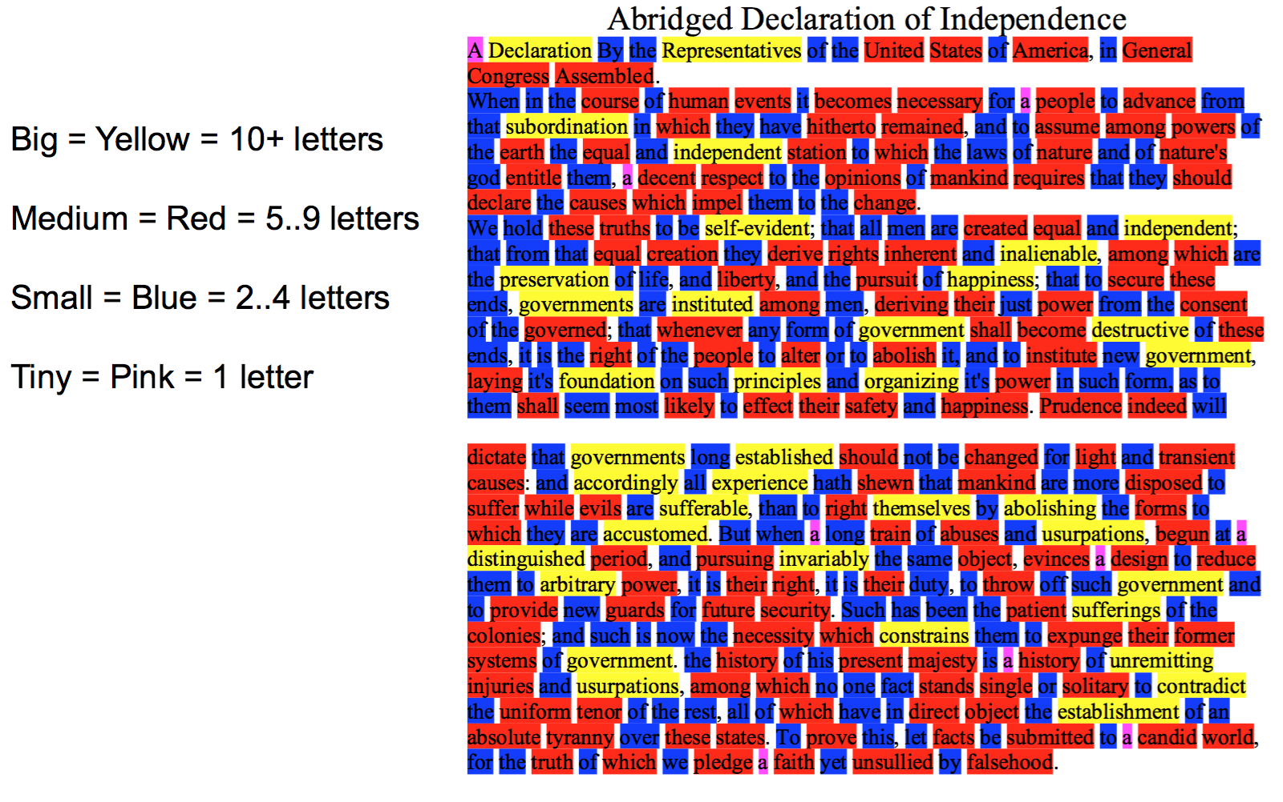
Example: Word Length Histogram

Slide 4
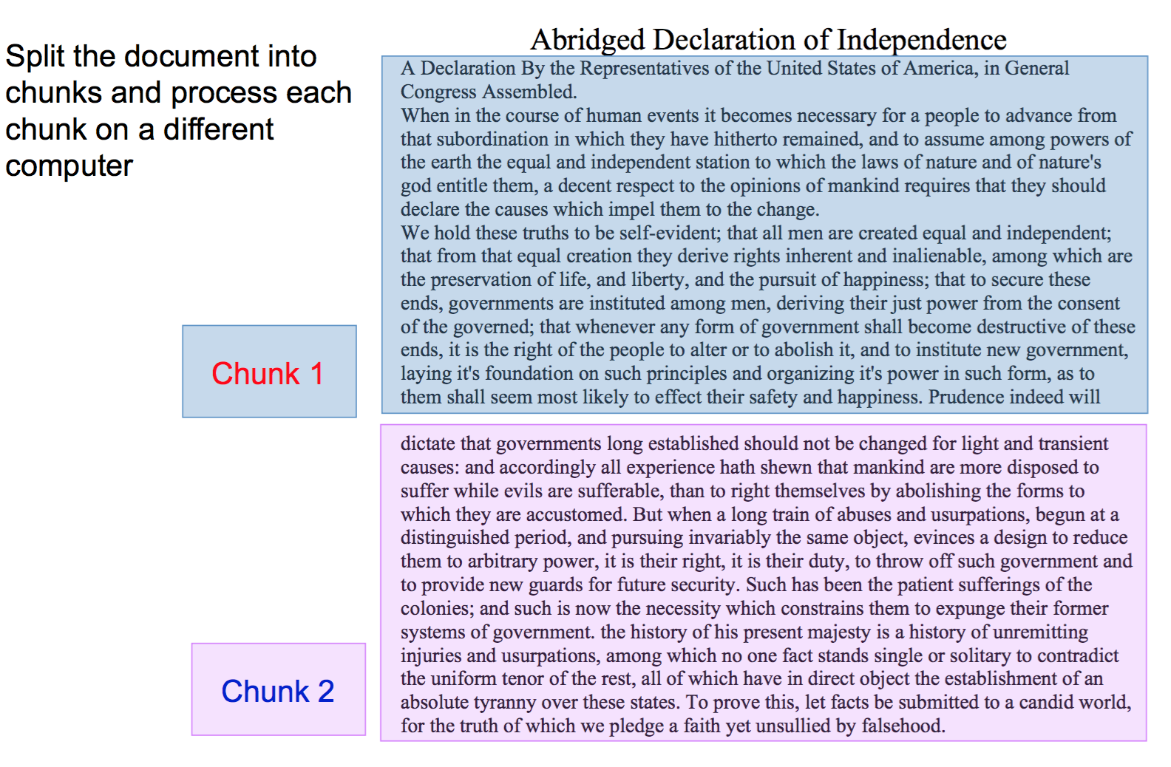
Example: Word Length Histogram

Slide 5
Example: Word Length Histogram

Slide 6
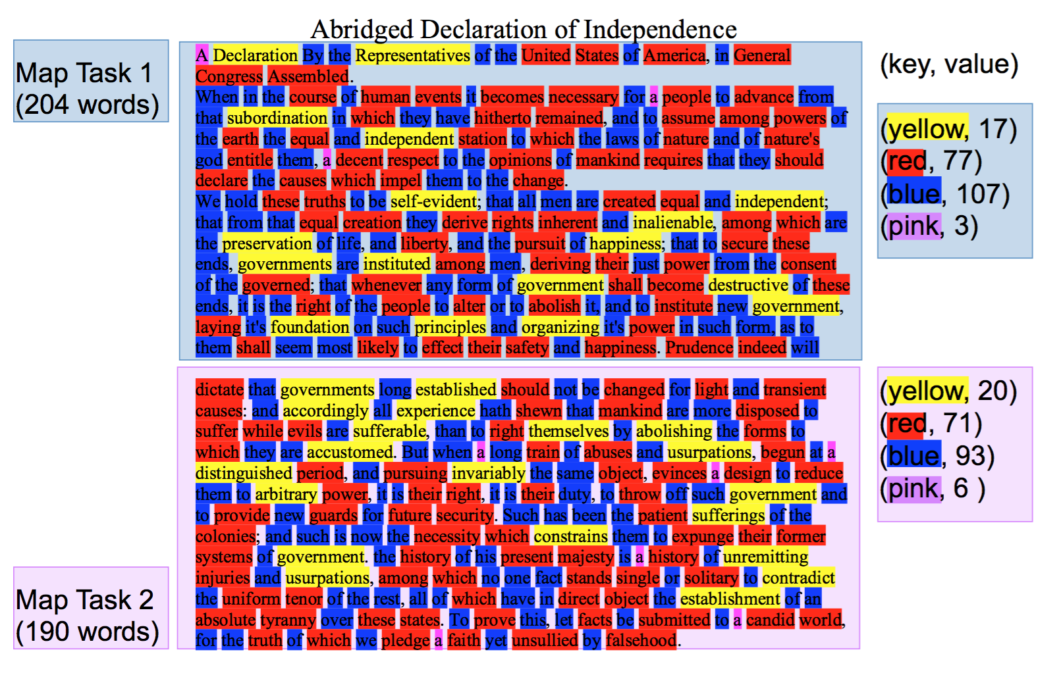
Example: Word Length Histogram

Slide 7
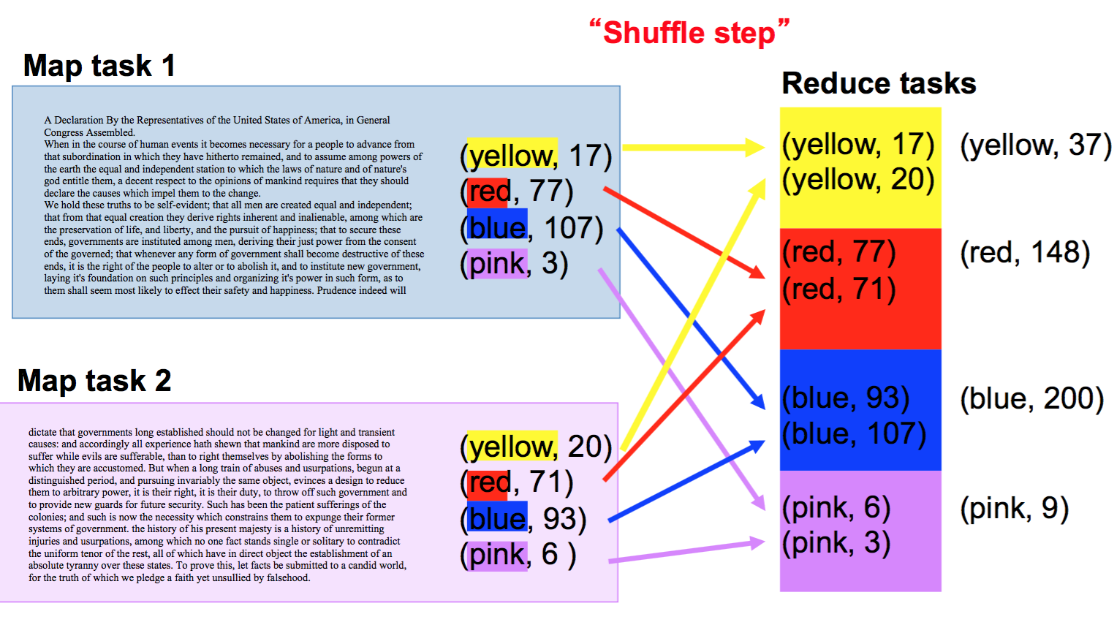
Example: Word Length Histogram

Slide 8
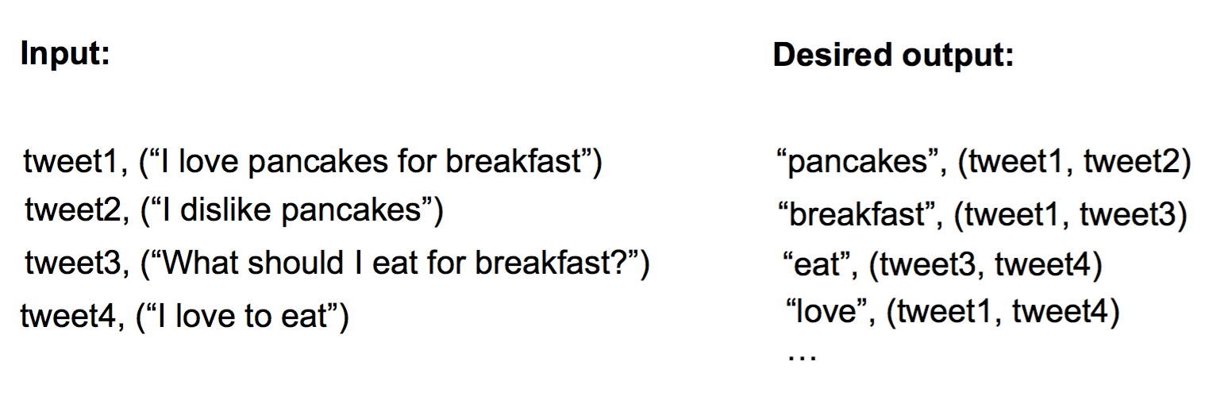
Example: Build an Inverted Index

Slide 9
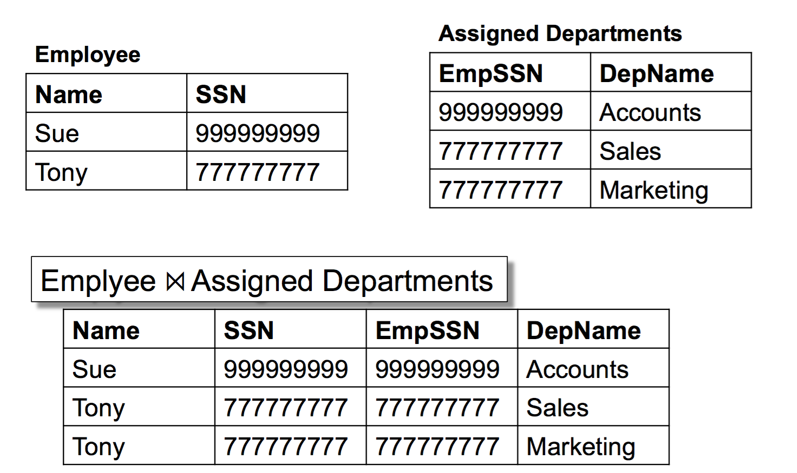
Example: Relational Join

Slide 10
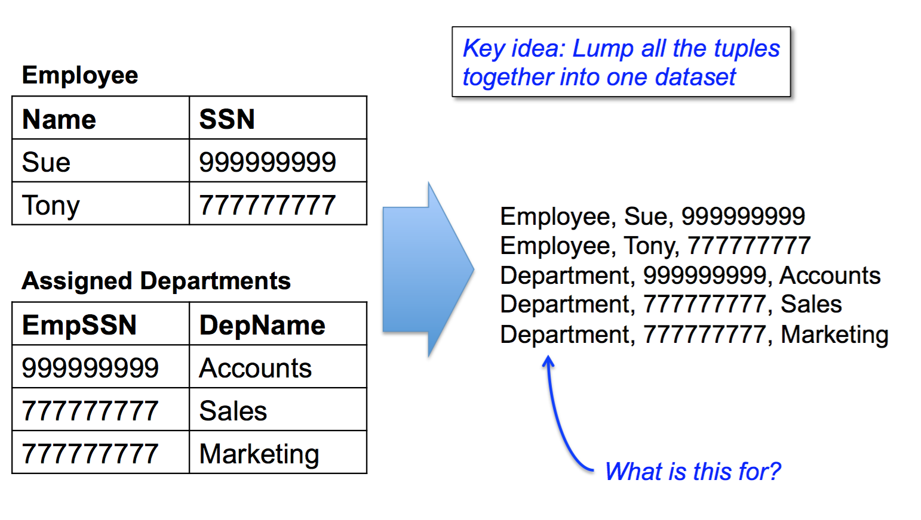
Relational Join in MapReduce: Before Map Phase

Slide 11
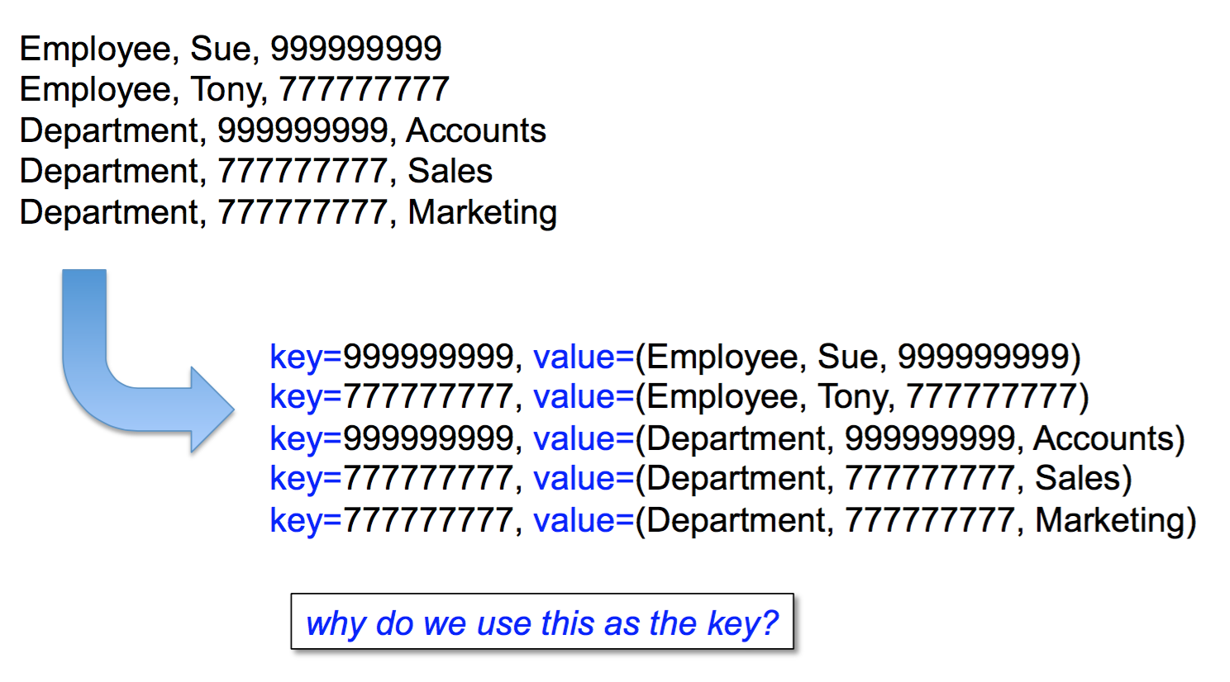
Relational Join: Map Phase

Slide 12
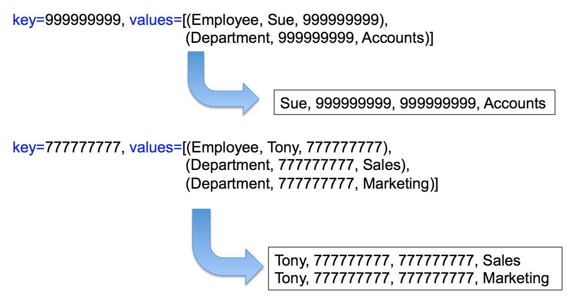
Relational Join: Reduce Phase

Slide 13
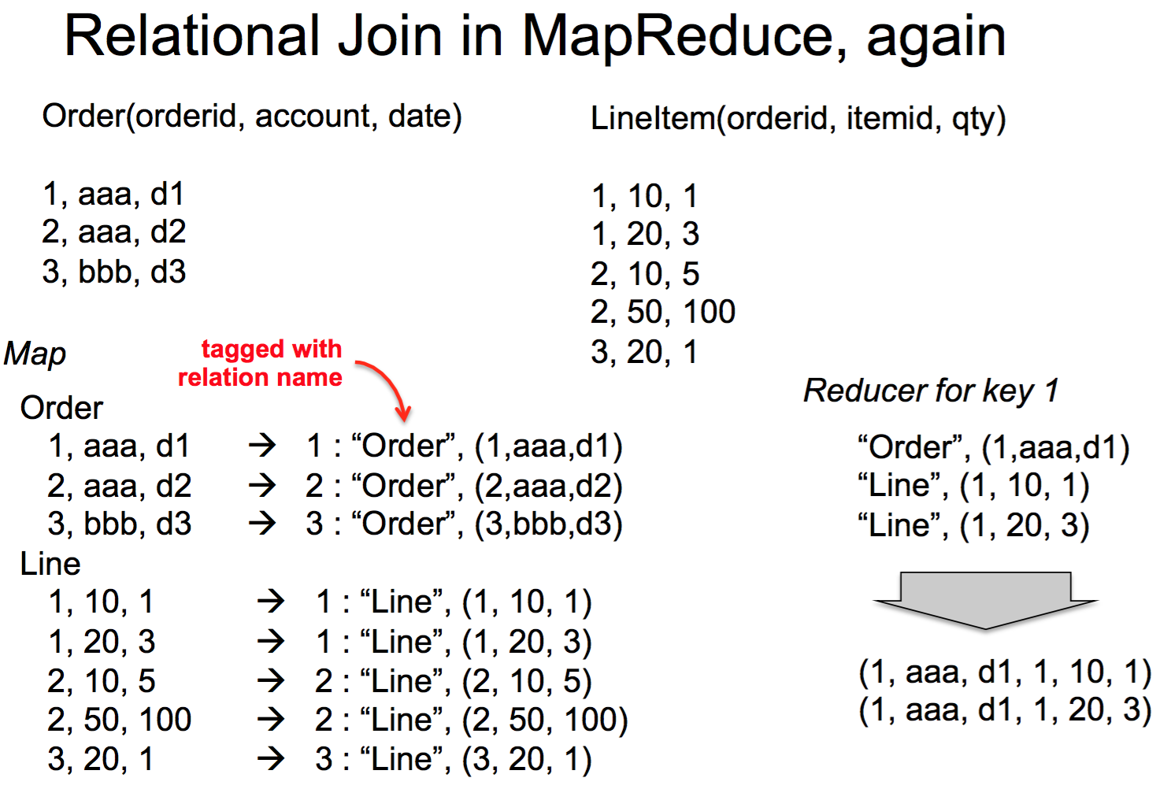

Slide 14
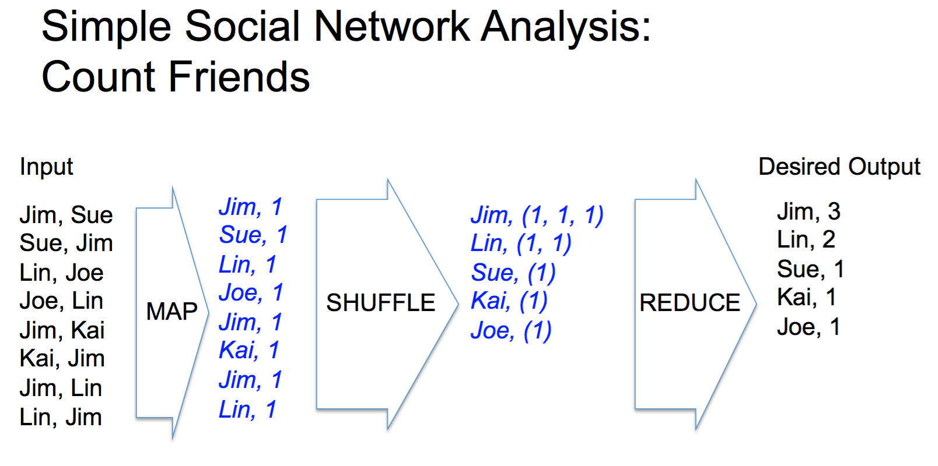

Slide 15
Matrix Multiply
C = A x B
In the map phase:
for each element (i,j) of A, emit ((i,k), A[i,j]) for k in 1..N
for each element (j,k) of B, emit ((i,k), B[j,k]) for i in 1..L
In the reduce phase:
Sum(A[i,j]*B[j,k])

Slide 16
